Slide 1
A proactive and collaborative DDoS mitigation strategy for the Dutch critical infrastructure
Cristian Hesselman¹, Jeroen van der Ham², Roland van Rijswijk³, Jair Santanna², Aiko Pras²

Slide 2
Aiko Pras
Prof. Internet Security
University of Twente
The Netherlands
https://people.utwente.nl/a.pras

Slide 3
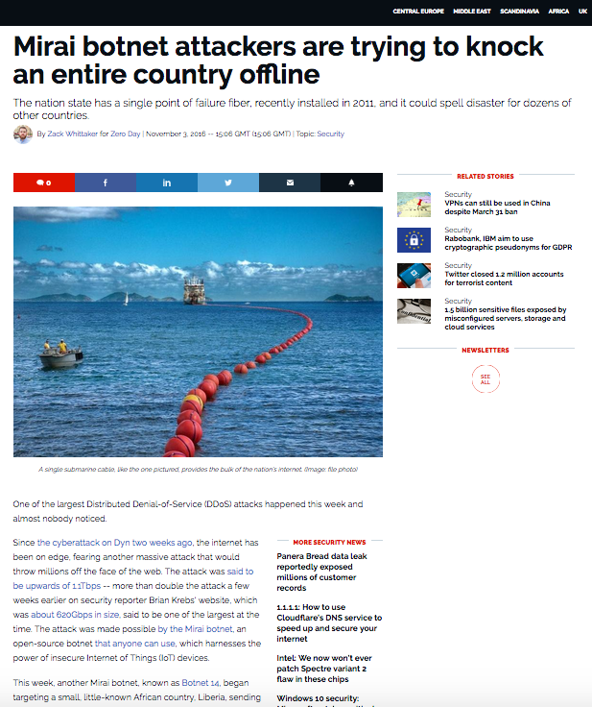
DDoS attacks (on the DNS)
D1
D2
HN1
DNS server
D3
ISP3
HN2
D4
ISP1
swarm of globally distributed compromised IoT devices
D5
ISP4
HN3
D6
D7
ISP2
D9
HN4
Booter
Other targets: OVH (hosting provider), Krebs On Security (website), Deutsche Telecom (ISP)
Control commands
D8
DDoS flow
HN = Home Network
D = IoT device
https://en.wikipedia.org/wiki/2016_Dyn_cyberattack
https://www.zdnet.com/article/mirai-botnet-attack-briefly-knocked-an-entire-country-offline/

Slide 4
DDoS trends
Volume at 1+ Tbps, likely going up (Dyn @ 1.2 Tbps, GitHub @ 1.3 Tbps)
Many widely distributed DDoS sources (Mirai: 600K, bots all over the world)
IoT bots mutating and spreading quickly (Mirai: 75-minute doubling time)
Easier to launch through booters/stressers (Mirai)
Combination of direct and reflection attacks (Mirai)
DNS increasingly a high-profile target (DNS root 2015, Dyn 2016)

Slide 5
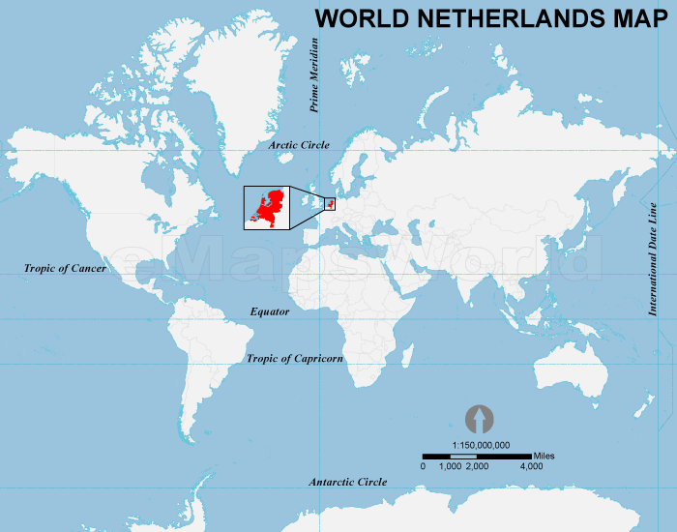
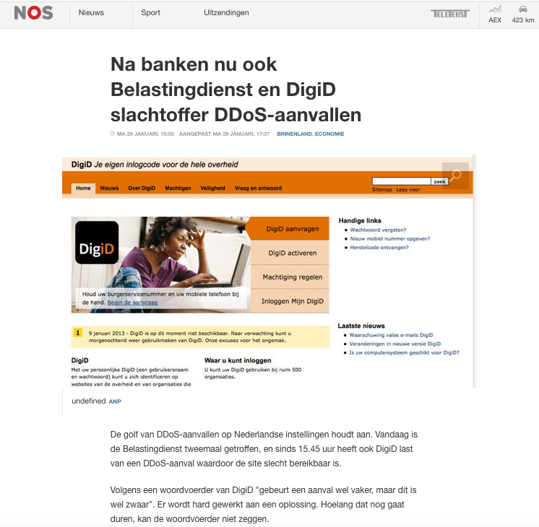
The Netherlands
DDoS attacks on Dutch critical infrastructure operators (Jan 2018)
Estimated 40 Gbps attacks resulted in service outages at several operators
Reactive and individual DDoS mitigation strategy
(Commercial) DDoS protection services per critical service provider
Person-to-person incident response communications during attacks

Slide 6
A proactive and collaborative strategy
Improve information position of Dutch critical service providers by continually and automatically sharing fingerprints of actual and potential DDoS sources
Widens view of critical service providers, enabling them to proactively prepare for attacks that have not hit them yet
Information provisioning layer that extends existing DDoS protection services that Dutch critical service providers use and does not replace them
Improve attribution of perpetrators and booter operators, allowing for better prosecution and increased deterrent effects
Onboard all critical providers in NL (Internet, financial, energy, water, etc.)

Slide 7
DDoS radar (IoT example)
DPS1
IoT-powered DDoS attack A (rerouted to DPS1)
Create fingerprint(A)
CSP1
Share fingerprint(A)
IoT honeypots
Booter locators
DDoS radar
DDoS sensors
Other fingerprints
Public Internet
CSP4
CSP3
Globally distributed “swarm” of compromised IoT devices
CSP2
Use fingerprint(A)
DNS anycast adaptation
Update traffic filters
Adapt rules for DPS invocation
DPS4
DPS3
DPS2
CSP = Critical Service Provider (e.g., a bank, ISP, or a registry)
DPS = DDoS Protection Service (e.g., Nawas or commercial such as Arbor)

Slide 8
Fingerprint
Summary of DDoS traffic
Domain names used
Source IP addresses
Protocol
Packet length
Created from traffic capture files like PCAPs
Victim IP addresses not part of fingerprint
Challenge: creation at high speed (10s of Gbps)

Slide 9
Status and next steps
DDoS radar embraced by broad coalition of 25 players from industry (ISPs, xSPs, IXPs, banks, not-for-profit DPS) and gov’t (ministries and agencies)
Dutch Continuity Board (DCB) acts as springboard, supported by Dutch National Cyber Security Center (NCSC-NL)
Develop DDoS radar based on existing components, such as
DDoS-DB of the University of Twente (ddosdb.org)
NaWas’ DDoS pattern recognition system (ddos-patterns.net)
Working groups: (1) clearing house, (2) cross-industry information sharing, (3) outreach, (4) ground rules and incident response, and (5) exercises

Slide 10
Longer-term
Pilot part of an EU cybersecurity research project (CONCORDIA) + development of a blueprint “business plan” to sustainably run (national) DDoS radars
Envisioned growth path: (1) Netherlands → Europe → global and (2) extend to “non-critical” service providers

Slide 11
Q&A

